Slide 1
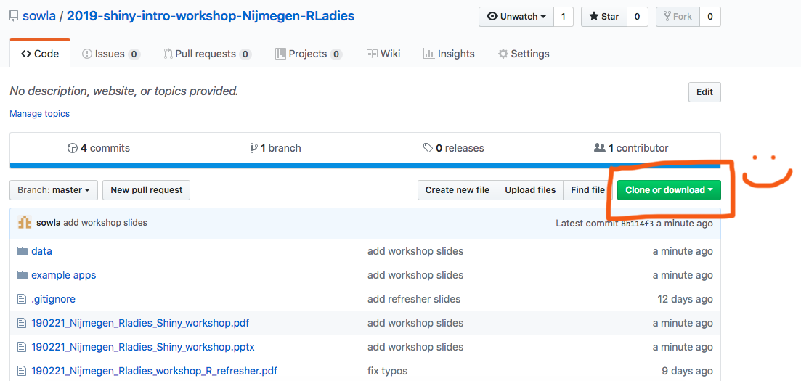
Please download this github repository: https://bit.ly/2BLmoGW

Slide 2

Introduction to
R-Ladies Nijmegen 21/02/19

Slide 3

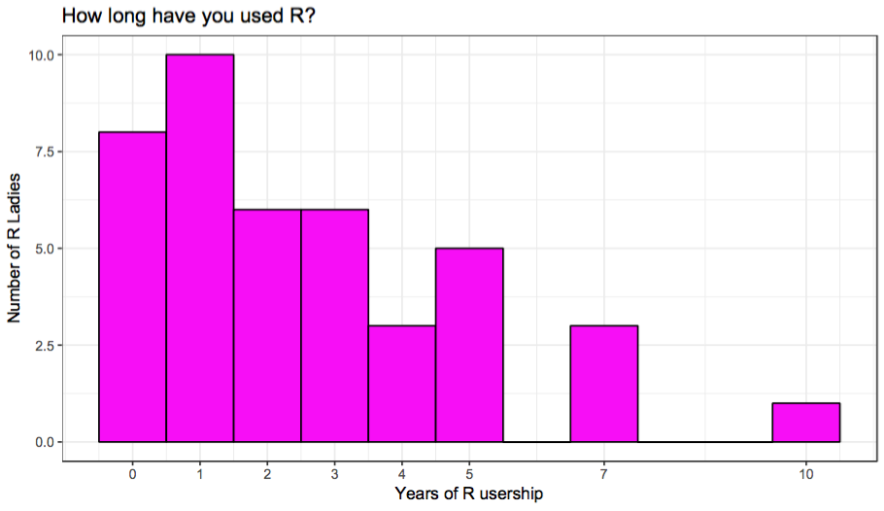


Hi!
I’m Suthira Owlarn :)
Biologist/postdoc in Kerstin Bartscherer’s Tissue Regeneration lab
MPI for Molecular Biomedicine (Münster)
Hubrecht Institute (Utrecht)
R newbie (~1.5 years)
Shiny enthusiast!
@s_owla
sowla

Slide 4
Tonight’s plan
Introduction + demo
Build a sample app together (with short exercises)
Build your own app (longer hands-on session)
Q&A/summary

Slide 5

Tonight’s plan
Introduction + demo
Build a sample app together (with short exercises)
Build your own app (longer hands-on session)
Q&A/summary
GIF by
Mara Averick (@dataandme)
Notes:
all practical parts will be indicated with this GIF :)

Slide 6
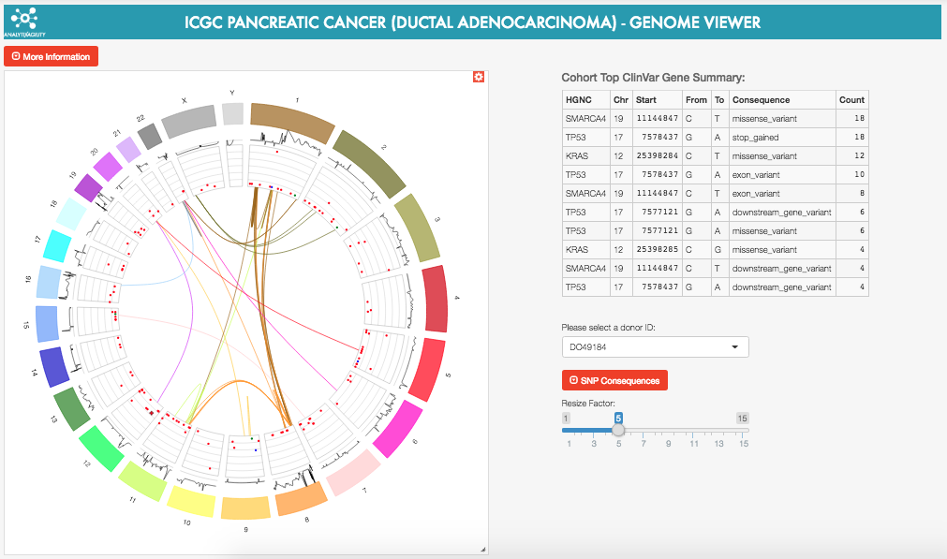
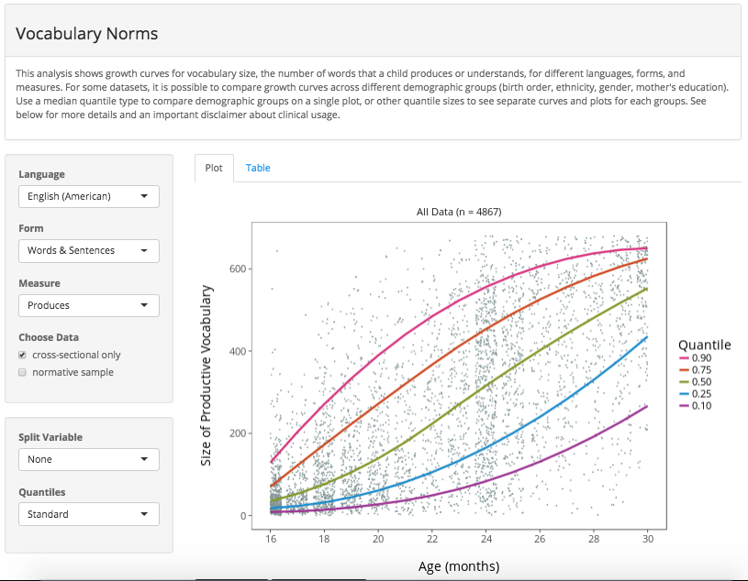
Shiny
A quick and easy way to provide a user-friendly interface to your analysis
ICGC pancreatic cancer genome viewer
Word Bank
shiny.rstudio.com/gallery
Notes:
Shiny is a package that lets you quickly make a user-friendly website for your data/model/analysis without having to learn a new language :) check out the gallery for a better idea of the kinds of things you can do with shiny!

Slide 7
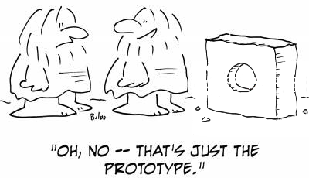
Demo

Slide 8
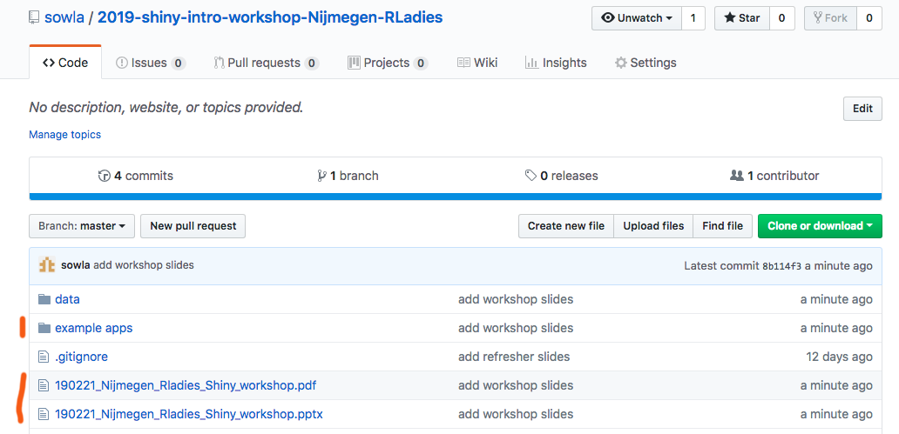
Getting started
Notes:
The scripts in the example apps folder are needed for the course. And you’ve found a copy of the slides :)

Slide 9
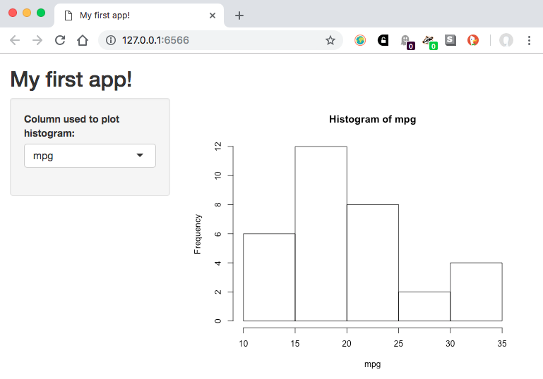
How does shiny work?
# plot a histogram
hist(
x = my_data[["mpg"]],
main = paste("Histogram of", "mpg"),
xlab = "mpg"
)
Translate R code into code for the user interface (UI)
Use R to do the server calculations behind the scene
Notes:
There are two parts of code in a shiny app:
all the “ui” code is translated from R into other languages to make the user interface (UI).
Unless you tell it otherwise, all the “server“ on-the-fly calculations are done in R – so when a user picks that they want to see a histogram of the mpg column, it's R that subsets the data frame and renders the corresponding plot.

Slide 10
How does shiny work?
Shiny hides many of the complexities :D
Many possible inputs and outputs
Lots of other customisations possible
But first we’ll focus on building one app together, step-by-step
Notes:
The great thing about shiny is it hides a alot of the complexities, so it's pretty easy to start making a simple app :) but once you get the hang of it, it's easy to build on top of that app and customise it!

Slide 11
Our target shiny app
Let’s have a look at the app we’re trying to build:
Open 1-target-app.R
Start the app (“run app”; top right of script panel)
Explore the app
Stop the app (“stop”; top right of console panel)
If you have extra time:
Go back to the browser
What happens when you try to use the app? Why?
3-5 minutes

Slide 12
A minimal shiny app
2-app-very-basic1.R:
library(shiny)
shinyApp(
ui = "", # what to go on the web page
server = function(input, output) {} # calculations done in R
)
Notes:
A minimal shiny app doesn’t look much like an app.. But if you try to type into the console, you’ll see that it’s busy (running the shiny app)! A couple of small changes will make it even clearer!!
shinyApp(
ui = "Hello!!", # this code appears in the browser
server = function(input, output) {
cat("How are you?") # the output of this code appears in the console
}
)
You can also break the code up into smaller chunks that will be easier to digest once your app grows:
ui <- "Hello!!", # this code appears in the browser
server <- function(input, output) {
cat("How are you?") # the output of this code appears in the console
}
shinyApp(ui = ui, server = server)

Slide 13
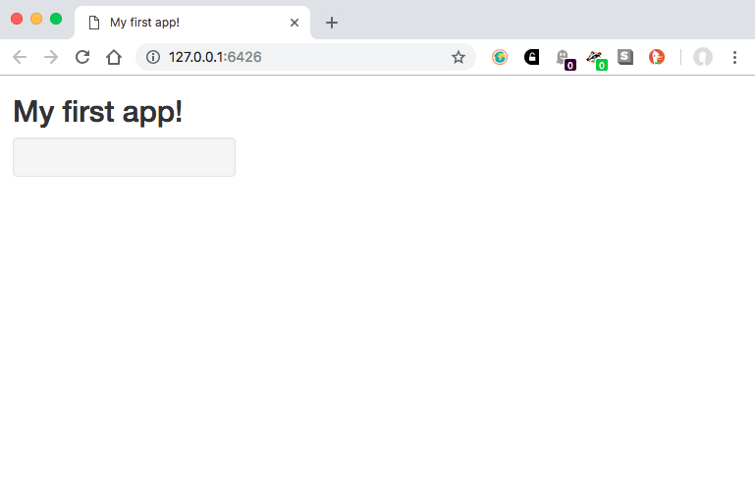
Building a user interface
ui <-
fluidPage(
titlePanel("My first app!"),
sidebarLayout(
sidebarPanel(),
mainPanel()
)
)
Notes:
Let’s focus on building the UI first. We’ll worry about writing the server code later.
Building the user interface is a bit like playing with Russian dolls :)

Slide 14
Building a user interface
ui <-
fluidPage(
titlePanel("My first app!"),
sidebarLayout(
sidebarPanel(),
mainPanel()
)
)
Notes:
One type of layout

Slide 15
Building a user interface
ui <-
fluidPage(
titlePanel("My first app!"),
sidebarLayout(
sidebarPanel(),
mainPanel()
)
)

Slide 16
Building a user interface
ui <-
fluidPage(
titlePanel("My first app!"),
sidebarLayout(
sidebarPanel(),
mainPanel()
)
)
3-very-basic-app2.R

Slide 17
Building a user interface
Value of ui in 3-very-basic-app2.R:
<div class="container-fluid">
<h2>My first app!</h2>
<div class="row">
<div class="col-sm-4">
<form class="well"></form>
</div>
<div class="col-sm-8">
</div>
</div>
</div>
ui <-
fluidPage(
titlePanel("My first app!"),
sidebarLayout(
sidebarPanel(),
mainPanel()
)
)
Notes:
Proof that shiny translates your R code: if you copy the code on the left hand side and retrieve the value of “ui”, you’ll get the HTML code on the right! :)
HTML code is heavily nested, therefore so is the shiny UI code

Slide 18
Building a user interface: your turn
Could you open 3-very-basic-app2.R and:
change the title of your app?
move the sidebar panel to the right?
If you have extra time:
Did your neighbours use the same method as you?
There’s more than one way to do this! :)
3-5 minutes

Slide 19
Building a user interface: your turn
Canonical way:
Gives the same result:
ui <-
fluidPage(
titlePanel("My new title!"),
sidebarLayout(
position = "right",
sidebarPanel(),
mainPanel()
)
)
ui <-
fluidPage(
h2("My new title!"),
sidebarLayout(
mainPanel(),
sidebarPanel()
)
)
Notes:
I don’t expect you to know both ways! I mainly want to make a point that there can be multiple ways to get something done :)

Slide 20
Building a user interface: your turn
My general mind set:
use the canonical way when there is one!
check documentation/internet for “lesser known” canonical way(s)
but don’t be afraid to be creative when there isn’t one! :)

Slide 21
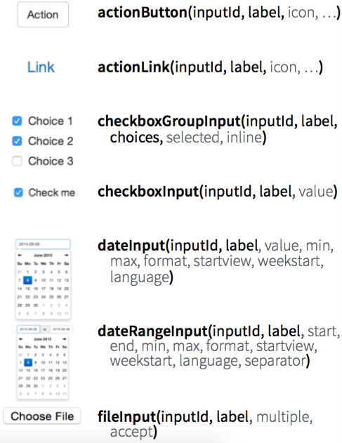
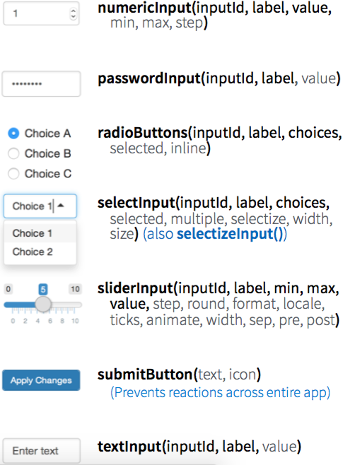
Building a user interface: inputs
From Rstudio’s Shiny cheatsheet
Notes:
Now that we have a layout, let’s put something on the page! Here are some inputs you can choose from and their corresponding functions.
But lets focus on one for now: once you know how to use one, it’s easy to use the others :)

Slide 22
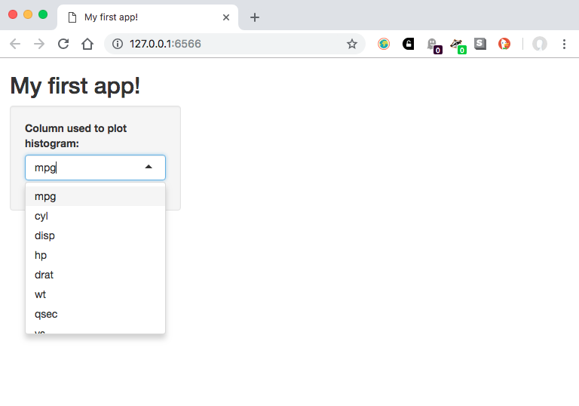
Building a user interface: inputs
sidebarLayout(
sidebarPanel(
selectInput(
inputId = "column",
label = "Column used to plot histogram:",
choices = names(mtcars)
)
),
mainPanel(
plotOutput(outputId = "plot")
)
)
Notes:
The code on the left generates the UI on the right..

Slide 23
Building a user interface: inputs
sidebarLayout(
sidebarPanel(
selectInput(
inputId = "column",
label = "Column used to plot histogram:",
choices = names(mtcars)
)
),
mainPanel(
plotOutput(outputId = "plot")
)
)
The input element goes in the sidebar panel
Notes:
The input element goes in the sidebar panel, so the selectInput function is nested in the sidebarPanel function

Slide 24
Building a user interface: inputs
sidebarLayout(
sidebarPanel(
selectInput(
inputId = "column",
label = "Column used to plot histogram:",
choices = names(mtcars)
)
),
mainPanel(
plotOutput(outputId = "plot")
)
)
Type of input
(dropdown menu)

Slide 25
Building a user interface: inputs
sidebarLayout(
sidebarPanel(
selectInput(
inputId = "column",
label = "Column used to plot histogram:",
choices = names(mtcars)
)
),
mainPanel(
plotOutput(outputId = "plot")
)
)
Unique ID so we can retrieve the correct values from it
Notes:
This is important when we later retrieve input values – this is the unique ID we’ll use to tell shiny which input we’re interested in

Slide 26
Building a user interface: inputs
sidebarLayout(
sidebarPanel(
selectInput(
inputId = "column",
label = "Column used to plot histogram:",
choices = names(mtcars)
)
),
mainPanel(
plotOutput(outputId = "plot")
)
)
Label to show above the input

Slide 27
Building a user interface: inputs
sidebarLayout(
sidebarPanel(
selectInput(
inputId = "column",
label = "Column used to plot histogram:",
choices = names(mtcars)
)
),
mainPanel(
plotOutput(outputId = "plot")
)
)
Choices to give in the dropdown menu

Slide 28
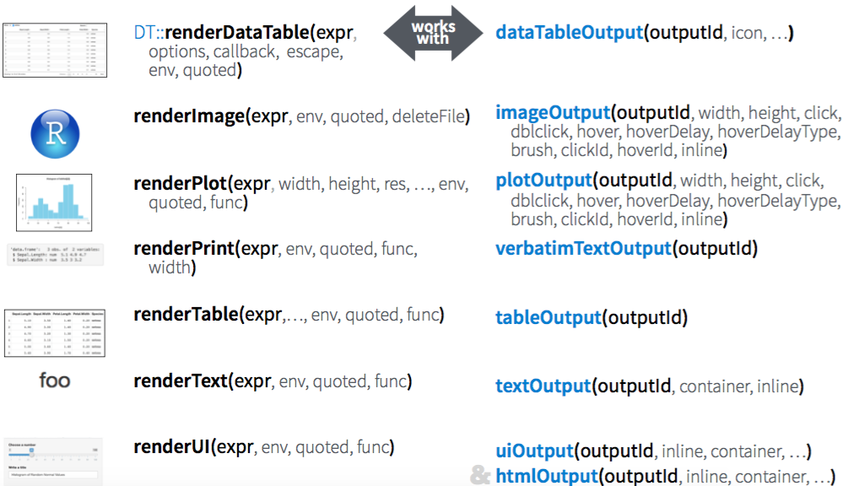
Building a user interface: outputs
From Rstudio’s Shiny cheatsheet
Notes:
It’s a similar story with outputs. For the UI, we’ll need the function(s) on the right. Today we want to plot a histogram, so we’ll use plotOutput. Again, we’ll use the unique output ID to tell shiny which output we’re interested in.

Slide 29
Building a user interface: outputs
sidebarLayout(
sidebarPanel(
selectInput(
inputId = "column",
label = "Column used to plot histogram:",
choices = names(mtcars)
)
),
mainPanel(
plotOutput(outputId = "plot")
)
)
The output element will go in the main panel
Notes:
For the output, we just need to say where on the ui it should go, and we’ll take care of the rest with the server code

Slide 30
Building a user interface: your turn
Sticking with 3-very-basic-app2.R, could you:
add a selectInput element for selecting the my_data column to plot?
Don’t forget: input ID, label and choices
add a plotOutput area for the histogram?
Don’t forget: output ID
If you have extra time:
Type e.g. `?selectInput` to see available arguments and try changing some of the defaults!
5-15 minutes
Notes:
OK, your turn! Try to do this task without going back to the previous slides :)
Answers: 4-app-with-ui.R

Slide 31
Building a user interface: summary
ui <- ""
server <- function(input, output) {
}
shinyApp(ui = ui, server = server)
...
selectInput(
inputId = "column",
label = "Column used to plot histogram:",
choices = names(my_data)
)
...
...
plotOutput(
outputId = "plot"
)
...
Start with a minimal template, then build on it
*Input() code:
- define input UI
(- where input UI goes)
*Output() code:
- what output accepted
(- where output goes)

Slide 32
Writing the server logic: revisiting outputs
From Rstudio’s Shiny cheatsheet
Notes:
Did you notice there was no plot in the previous app? That’s because we haven’t told shiny how to generate the output. For that, we need the functions on the left on this slide.

Slide 33
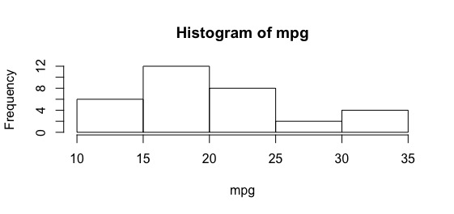
Writing the server logic: revisiting outputs
Generic R code:
# plot a histogram of mtcars$mpg
hist(
x = mtcars[["mpg"]],
main = paste("Histogram of", "mpg"),
xlab = "mpg"
)
Notes:
I think the easiest way to write shiny server code is is to start with the code that you’d normally use in a generic script.
Let’s first focus on getting a plot on the app, so I’ve just picked one column (mpg) for plotting a histogram.

Slide 34
Writing the server logic: revisiting outputs
Generic R code:
Shiny server code:
# plot a histogram of mtcars$mpg
hist(
x = mtcars[["mpg"]],
main = paste("Histogram of", "mpg"),
xlab = "mpg"
)
# shiny output version
output$plot <- renderPlot({
hist(
x = mtcars[["mpg"]],
main = paste("Histogram of", "mpg"),
xlab = "mpg"
)
})
Notes:
All we have to add to the generic R code to make it shiny compatible is to add these two lines

Slide 35
Writing the server logic: revisiting outputs
What kind of output (matches type in UI code)
# relevant ui code:
mainPanel(
plotOutput(outputId = "plot")
)
# relevant server code:
output$plot <- renderPlot({
hist(
x = mtcars[["mpg"]],
main = paste("Histogram of", "mpg"),
xlab = "mpg"
)
})
Notes:
One is what kind of output to render, which should match function in the UI code

Slide 36
Writing the server logic: revisiting outputs
Where the output should appear (matches output ID in UI code)
# relevant ui code:
mainPanel(
plotOutput(outputId = "plot")
)
# relevant server code:
output$plot <- renderPlot({
hist(
x = mtcars[["mpg"]],
main = paste("Histogram of", "mpg"),
xlab = "mpg"
)
})
Notes:
And the other is where the output should appear; so the id in the server and ui have to match

Slide 37
Writing the server logic: revisiting outputs
`output` is a named list, values can be stored with the help of `$`
# relevant ui code:
mainPanel(
plotOutput(outputId = "plot")
)
# relevant server code:
output$plot <- renderPlot({
hist(
x = mtcars[["mpg"]],
main = paste("Histogram of", "mpg"),
xlab = "mpg"
)
})
Notes:
If you don’t know what a named list is, feel free to ignore this slide :)
If you’re comfortable with named lists, it might be helpful to know that all shiny inputs and outputs are stored in named list called input and output, respectively. They’re passed as arguments to the server function – that’s the reason behind the output$id syntax
shinyApp(ui = ””, server = function(input, output) {})

Slide 38
Writing the server logic: your turn
Without looking at previous slides, could you:
Edit the server logic as explained in 5-app-with-server1.R
If you have extra time:
What other attributes in the output might you want to change?
What kind of inputs would you need?
Which input elements might be suitable for them? (see this widget gallery for ideas)
3-5 minutes
Notes:
Now we have a plot! But the output isn’t linked to the input in anyway..

Slide 39
Writing the server logic: linking inputs and outputs
Incorporating the input in the server code to generate the output:
what does our input data look like?
can’t type into console while shiny app is running..
print() and cat() are your friends!
Let’s try with 6-app-with-server2.R
Reactivity: notice the code is rerun every time we pick a new input
-> this is why the output will update as the input changes
Notes:
How could we incorporate the input into our server code? My first step is generally to check what the input looks like
Also note the reactivity: when you first load the app, “mpg” is selected in the input. See how what’s shown in your console changes as you select different inputs: what changes and what stays the same? Why?

Slide 40
Writing the server logic: linking inputs and outputs
`input` is also a named list; values can be retrieved with `$`
# relevant ui code:
selectInput(
inputId = "column",
label = "Column used to plot histogram:",
choices = names(mtcars)
)
# linked to input
output$plot <- renderPlot({
hist(
x = mtcars[[input$column]],
main = paste("Histogram of", input$column),
xlab = input$column
)
})
Notes:
Similar to outputs part :)

Slide 41
Writing the server logic: linking inputs and outputs
Which input to retrieve data from (matches input ID in UI code)
# relevant ui code:
selectInput(
inputId = "column",
label = "Column used to plot histogram:",
choices = names(mtcars)
)
# linked to input
output$plot <- renderPlot({
hist(
x = mtcars[[input$column]],
main = paste("Histogram of", input$column),
xlab = input$column
)
})
Notes:
Now we’re using a specific input in our server code. So as the input value changes, so will the code! :)

Slide 42
Writing the server logic: your turn
Without looking at previous slides, could you:
Edit the server logic in 6-app-with-server2.R so the output changes depending on the input
If you have extra time:
What other attributes in the output might you want to change?
What kind of inputs would you need?
Which input elements might be suitable for them? (see this widget gallery for ideas)
3-5 minutes
Notes:
Answer: we did it!! 7-target-app.R

Slide 43
Building a user interface: summary
output$plot <- renderPlot({
hist(x =
mtcars[[input$col]]
)
})
output$plot <- renderPlot({
hist(x =
mtcars[[input$col]]
)
})
output$plot <- renderPlot({
hist(x =
mtcars[[input$col]]
)
})
Use input values in calculation function with input$input_id
Wrap calculation function with render*().
Assign function output to output$output_id

Slide 44
Adding complexity: reading data from a file
see 8-csv-data.R
Before:
After:
# "read in" data
my_data <- mtcars
# read in data
my_data <-
read.csv("../data/mtcars.csv", row.names = 1)
Notes:
What if you want to use your own data?

Slide 45
Adding complexity: reading data from a file
Before:
After:
First column is row names
# "read in" data
my_data <- mtcars
# read in data
my_data <-
read.csv("../data/mtcars.csv", row.names = 1)
Function to read file
Path to file
Notes:
Adjust the code like any other R script! :)

Slide 46
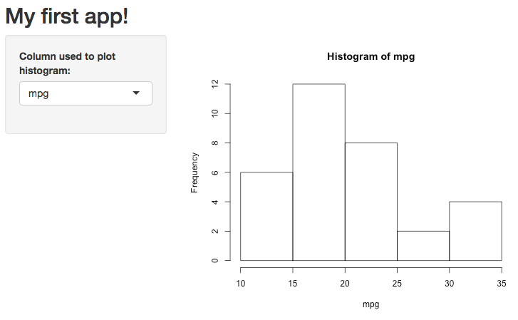
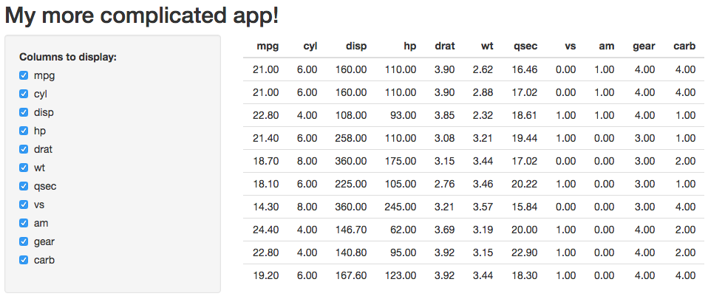
Adding complexity: replacing inputs/outputs
see 9-replace-io.R
Before:
After:
Notes:
Let’s try to change our input and output types: I want a group of checkboxes to (de)select which columns of data to show on the table.
To make life easy, let’s show the first ten rows of mtcars with mtcars[1:10, ]

Slide 47
Adding complexity: replacing inputs/outputs
Change output
# relevant ui code:
mainPanel(
tableOutput(outputId = "table")
)
# relevant server code:
output$table <- renderTable({
mtcars[1:10]
})
Notes:
Let’s render a table now, and change the corresponding ui and server code accordingly

Slide 48
Adding complexity: replacing inputs/outputs
Change output
# relevant ui code:
mainPanel(
tableOutput(outputId = "table")
)
# relevant server code:
output$table <- renderTable({
mtcars[1:10]
})
Notes:
Some for the output id!

Slide 49
Adding complexity: replacing inputs/outputs
How do you plan to transform the data?
# relevant ui code:
checkboxGroupInput(
inputId = "columns",
label = "Columns to display:",
choices = names(my_data),
selected = names(my_data)
)
# relevant server code:
output$table <- renderTable({
mtcars[1:10, 1:3, drop = FALSE]
})
Pick which column(s) to show
Notes:
For the actual server code, think about how you want to transform the data. You want to pick a subset of columns; I’m testing with the first three columns.
By default, if the user picks one column only, a vector would be returned (one dimension); drop = FALSE makes sure a data frame is returned (two dimensions).

Slide 50
Adding complexity: replacing inputs/outputs
What’s the corresponding input for that?
# relevant ui code:
checkboxGroupInput(
inputId = "columns",
label = "Columns to display:",
choices = names(my_data),
selected = names(my_data)
)
# relevant server code:
output$table <- renderTable({
mtcars[1:10, 1:3, drop = FALSE]
})
Notes:
Based on how I want to transform the data, what do I want the users to be able to control? How does that affect my input choices/options?

Slide 51
Adding complexity: replacing inputs/outputs
What does your input look like?
# relevant ui code:
checkboxGroupInput(
inputId = "columns",
label = "Columns to display:",
choices = names(my_data),
selected = names(my_data)
)
# relevant server code:
output$table <- renderTable({
cat(input$columns)
cat(class(input$columns))
mtcars[1:10, 1:3, drop = FALSE]
})
Notes:
“Luckily” ;) input$columns returns a character vector, which we can also use to subset mtcars, eg:
mtcars[1:10, c("mpg", "cyl", "disp")]
Note: more complicated uses may require more exploring/creativity

Slide 52
Adding complexity: replacing inputs/outputs
Link input to output
# relevant ui code:
checkboxGroupInput(
inputId = "columns",
label = "Columns to display:",
choices = names(my_data),
selected = names(my_data)
)
# relevant server code:
output$table <- renderTable({
mtcars[1:10, input$columns,
drop = FALSE]
})
Notes:
Remember to check the input ids match: be careful with typos and ‘s’!

Slide 53
Adding complexity: your turn!
Multiple inputs
using two variables and adding shape/colour option
allowing users to add their own text for title/labels
giving a choice between base and ggplot
Multiple/different outputs
add table of summary statistics
add a logo and text summarising data
Different data
read in your own data
use the survey data
Until 8:20pm
Notes:
I think you’re ready to start building on your app! Here are a few ideas to get you started.. have fun!

Slide 54
Reminder: inputs
From Rstudio’s Shiny cheatsheet

Slide 55
Reminder: revisiting outputs
From Rstudio’s Shiny cheatsheet

Slide 56
Adding complexity: your turn (more advanced)!
Do you plan to have users upload their data onto your app?
Example in: 10-uploaded-data.R
Requires reactive(), observeEvent() and req()
Until 8:20pm
Notes:
I didn’t prepare materials for this because I planned to help a small group during the live workshop. Check the example app and https://shiny.rstudio.com/articles/ if you’re interested :)

Slide 57
Tips
My general workflow
Analyse/visualise the data until you’re clear what you want to show
Write functions that work outside of a shiny app
Imagine/draw the layout, then write the UI code (provides structure)
Edit the functions into server code
Repeat if you want to add more features!
Cmd/Ctrl + I to auto-indent for readability
cat(), print() and verbatimText for simple debugging
switch()/dplyr::case_when() as alternatives to multiple if/else
Notes:
Extra note: if your app gets big, you can test a few feature in a separate small app until you’re sure about how it works. Then add the new feature.

Slide 58
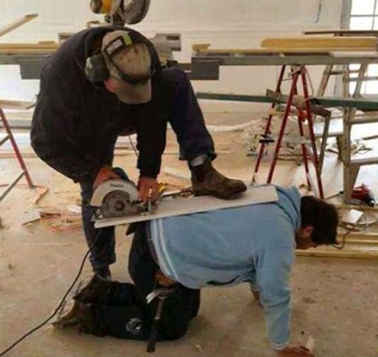


Slide 59
Tools/resources that make our lives easier
shiny.rstudio.com
gallery
tutorial, cheatsheet
reference or type ?<function_name> in your console
articles, e.g. debugging shiny apps (quite different from normal scripts)
Shiny section of Rstudio community
More from me:
shiny “extensions” talk and corresponding notes for more tools!
feel free to ask me questions: @s_owla on twitter/message me on meetup :)

Slide 60
Tools/resources that make our lives easier: your turn!
I (and I think many others) would love to learn from you! :)
R-Ladies chapters
R-Ladies rotating curator twitter account
R user groups
Put your code on github
Share your ideas/code/writing on #rstats twitter
So many more ways!!
On-going! :)
Notes:
Even if you’re new to R/programming – I really think newbies can teach and learn from each other :)

